Slide 1
Roadmap
Security Model
Ecosystem, Reference implementations, etc.
Application-TEE, Confidential Compute, and Capabilities-Based (AP-TEE)
AP-TEE TG + Cap-based TG(?)
Lightweight TEE
Pointer Masking (J extension)
Memory Tagging
Control Flow Integrity (CFI)
CFI TG(s): Temporal Fencing, and others
Blockchain whitepaper
International Scalar Crypto
Scalar Crypto
Vector Crypto
PQC Crypto
IOMMU within Software HC
IOMMU
S-mode MPU
ePMP
IOPMP
Microarchitectural Side Channel (uSC) leakage mitigations
uSC TG(s)
2021
2022
2023
SIG work
TG work
HC work

Slide 2
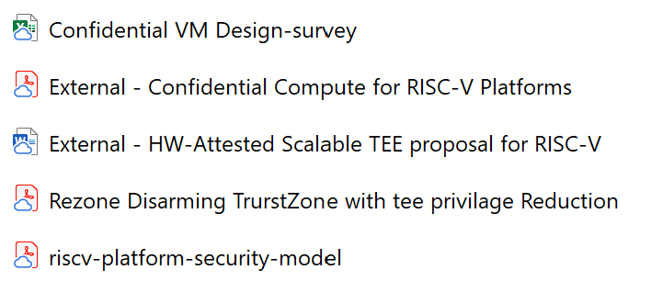
Agenda
https://github.com/riscv-admin/trusted-computing/tree/main/meetings/15-03-2022
https://arxiv.org/abs/2203.01025
Review CVM design survey
Is it applicable for RISC-V?
AP-TEE updates
New TG formed
Chairs meeting preparation for tomorrow for confidential computing directions

